Slide 1
Dr. MARY MCLEOD BETHUNE
THE BLACK VELVET ROSE
By Dr. Nancy Long
The Black Velvet Rose is available on Amazon

Slide 2
Born near Mayesville, SC, 1875

Slide 3
Mary’s Parents
Patsy and Sam McLeod had
17 children. They were former slaves, and Mary was their 15th child and their first free born child.

Slide 4
McLeod’s Homestead

Slide 5
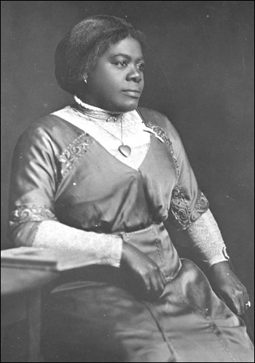
1882: Mary is chosen to attend school in Mayesville and walks 5 miles to and from school
1887: Mary receives a scholarship to attend Scotia Seminary in Concord, North Carolina.
Notes:
Mary Chrisman from Colorado, a Quaker woman, gave scholarship and Mary was able to attend Scotia Seminary

Slide 6
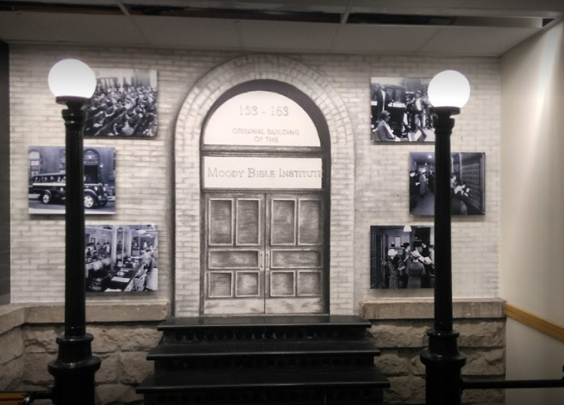
1894: Mary is the only Negro to attend the Moody Bible Institute in Chicago, Illinois.

Slide 7
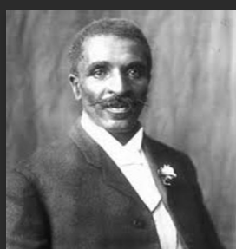
Albertus Bethune
Mary got a job in Atlanta, GA., and met Albertus in the church choir. They married in 1898, and their only son Albert was born one year later. He died in 1918 at the age of 48.
Notes:
Mary caught Albertus in a compromising situation with a school employee when she returned home from a board meeting and his bags were packed and he left the next morning.

Slide 8
Mary and her son Albert (born in 1899)
Notes:
Also a single mother who raised her son, grandson, and many other youth.

Slide 9
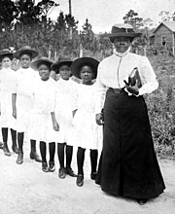
Oct. 4, 1904, Mary opens her Daytona school.
Mary had $1.50 and shook hands with John Williams who rented her a house for $11 a month. Within one year, she needed more space as so many mothers wanted their children to attend her school.

Slide 10
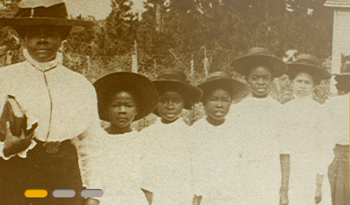

Slide 11
"I had no furniture. I begged dry goods boxes and made benches and stools; begged a basin and other things I needed and in 1904 five little girls here started school."
- Mary McLeod Bethune
Notes:
Mary never took no for an answer.

Slide 12
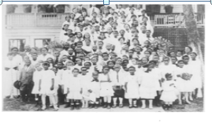
Mary purchased “Hell’s Hole” dump for $250 and the Daytona Normal and Industrial Institute was established there in 1907.

Slide 13
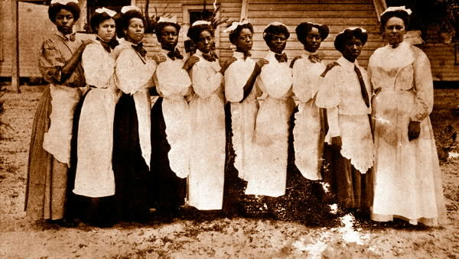
Cooking class, Daytona Educational and Industrial Training School for Negro Girls

Slide 14

Girls doing laundry.
The motto of the school was “Enter to learn: Depart to serve.”
The goal was to educate the “heart, mind and hands” of the students so that they would be educated and also have a practical skill as a livelihood to become a contributing individual to society.

Slide 15
"No matter how deep my hurt, I always smiled. I refused to be discouraged, for neither God nor man can use a discouraged person."
- Mary McLeod Bethune

Slide 16
Mr. Gamble
Where is this school? “In my mind and in my soul!” Mary replied.

Slide 17
John White
Donated trust funds for White Hall built in 1918

Slide 18
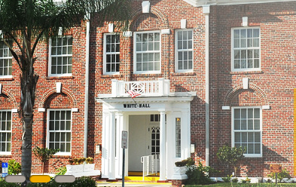
WHITE HALL AS IT LOOKS TODAY

Slide 19
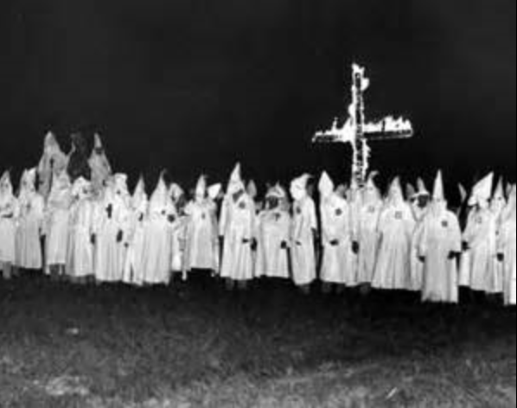
The Klu Klux Klan tried to get a KKK supporter elected in 1917.

Slide 20
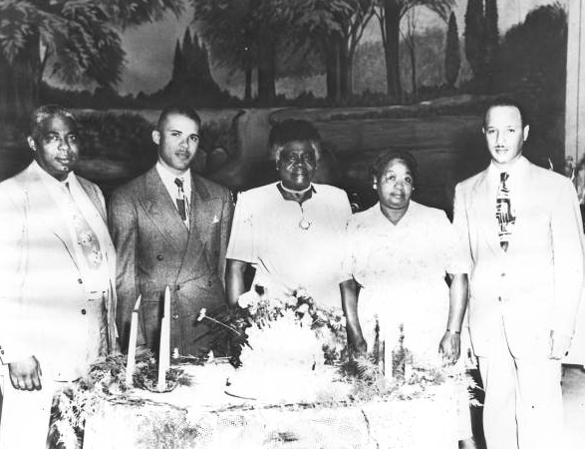
Bethune family (1948)
L-R: Son, Albert M. Bethune, Sr.; grandson whom she raised, Albert M. Bethune, Jr.; Dr. Mary McLeod Bethune; niece, George McLeod and her foster son Edward R. Rodriguez.

Slide 21
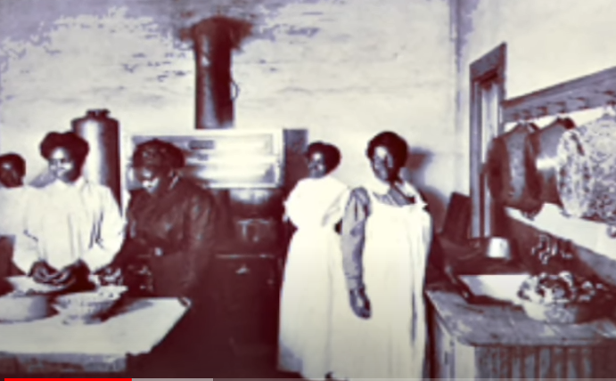
Students learned useful skill. Mary believed in “educating the hand, heart, and head.”

Slide 22
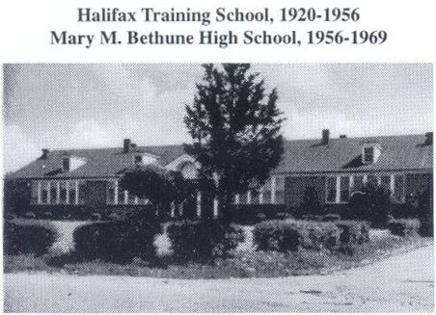

Slide 23
The Black Velvet Rose (1927)
“Roses of every color! And in the midst of the garden I saw a great big Black Velvet Rose. I never saw a Black Velvet Rose before, and I said to myself, ‘Oh! This is the great interracial garden; this is the garden where we have people of all colors, all classes, all creeds. .. This shall always be before me as a great Interracial Garden where men and women of all tongues, all nations, all creeds, all classes blend together helping to send out sunshine and love and peace and brotherhood that make a better world in which to live.’”

Slide 24
1928:
Hurricane hits Florida, and Mary organizes the rescue efforts through the Red Cross.
1930:
She attends her first White House Conference dealing with Child Health and Protection.
1935:
The NAACP awards Mary the Joel E. Springarn Gold Medal for her achievements.
1935:
Mary founds the National Council of Negro Women.
1936:
She becomes the Director of Negro Affairs for the National Youth Administration.

Slide 25
National Association of Colored Women’s Headquarters was dedicated on July 28, 1928, at the location of Twelfth and O Streets. At the end of her speech, she read the following poem:
If you can’t be a pine on top of the hill,
Be a scrub in the valley;
But be the best little scrub
That grows by the till.
Be a bush, if you can’t be a tree.
If you can’t be a bush, be a bit of the grass.
And some highway the happier make.
If you can’t be a muskie, just be a bass,
But be the liveliest bass in the lake.

Slide 26
We can’t all be captains; we’ve got to be crew,
There’s plenty of work for us here.
There’s a big work to do and a lesser;
But our task is the one that is near.
If you can’t be a highway, just be a trail,
If you can’t be a sun, be a star.
It’s not in your size you win or lose,
Be the best of what ever you are!

Slide 27
Mary advised four presidents and was very influential in D.C.

Slide 28
Mary and Eleanor Roosevelt

Slide 29
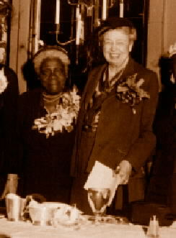
Mary and Eleanor Roosevelt

Slide 30
1943:
Mary is a general in the Women’s Army for the National Defense.

Slide 31
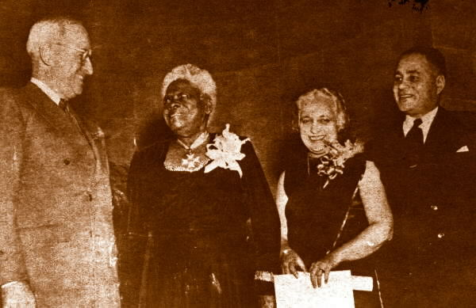
Mary McLeod Bethune awarded citation from Harry S. Truman
L-R: Harry S. Truman; Mary McLeod Bethune; Madame Vijaya Pandit, India's ambassador; and Dr. Ralph Bunche of the UN. All are recipients of the Citation for Outstanding Citizenship from the President.

Slide 32
1949: Mary is awarded the Medal of Honor and Merit in Haiti.
1952: She receives the Order of the Star of Africa from the Liberian president and tours Africa.

Slide 33
1954: Mary attends the
World Assembly for
Moral Re-Armament
in Caux, Switzerland.

Slide 34
Mary at White Hall

Slide 35
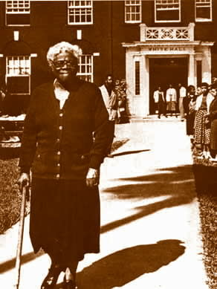

Slide 36
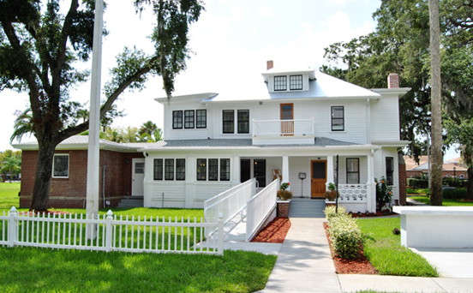
The Foundation where Mary spent her final years.

Slide 37
Mary at her Retreat
May 18, 1955: Mary dies of a heart attack in her Retreat home.

Slide 38
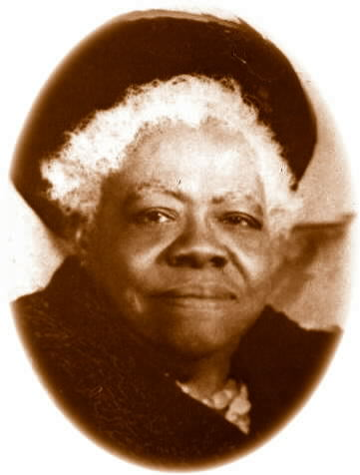
Born July 10, 1875 Mary Jane McLeod
Died May 18, 1955 Mary McLeod Bethune

Slide 39
Albert Jr., grandson/adopted son, with stamp dedicated on March 5, 1985.

Slide 40
LAST WILL AND TESTAMENT
Truly, my worldly possessions are few.
Yet my experiences have been rich.
From them I have distilled principles and policies in which
I believe firmly, for they present the meaning of my life’s work.
They are the products of much sweat and sorrow.
Perhaps, in them, there is something of value.
So as my life draws to a close, I will pass them on
to Negroes everywhere in the hope that an old woman’s philosophy
may give them inspiration.
Here, then, is my legacy.

Slide 41
I leave you love. Love builds. It is positive and helpful. Personally and racially, our enemies must be forgiven.
I leave you hope. The Negroes growth will be great in the years to come.
I leave you the challenge of developing confidence in one another. As long as Negroes are hemmed into racial blocks of prejudice and pressure, it will be necessary for them to band together for economic betterment.
I leave you a thirst for education. Knowledge is the prime need of the hour.
I leave you faith. Faith is the first factor in life devoted to service. Without faith, nothing is possible. With it, nothing is impossible. Faith in God is the greatest power, but great too is faith in oneself.
I leave you racial dignity. I want Negroes to maintain their human dignity at all costs.

Slide 42
I leave you a desire to live harmoniously with your fellow man. The problem of color is worldwide. And I appeal to American Negroes, both North and South, East and West- to recognize their common problems and unite to solve them.
I leave you finally a responsibility to our young people. The world around us really belongs to youth, for youth will take over its future management. Our children must never lose their zeal for building a better world; they must not be discouraged from aspiring toward greatness, for they are to be the leaders of tomorrow.

Slide 43
If I have a legacy to leave my people, it is my philosophy of living and serving.
As I face tomorrow, I am content, for I think I have spent my life well.
I pray now that my philosophy may be helpful to those who share my vision of the world. Peace.

Slide 44
Statue in Washington, D.C.
(July 10,1974)

Slide 45

Mary’s dream came true and her small girls’ school begun in 1904 is now Bethune-Cookman University .

Slide 46
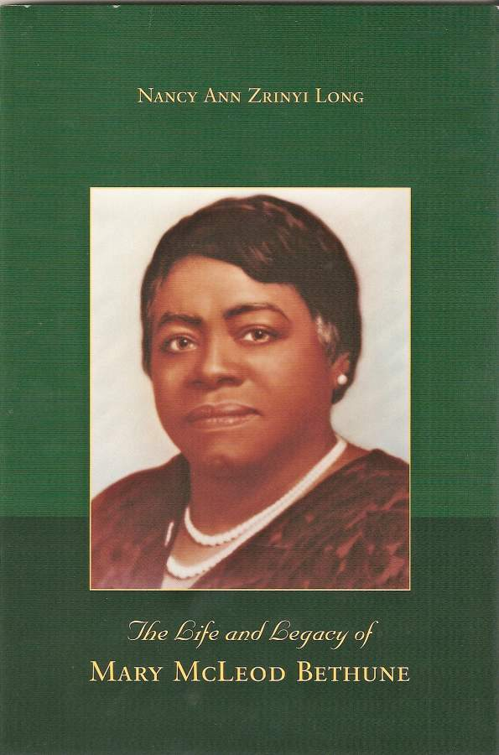
“Without faith, nothing is possible. With faith, nothing is impossible.”
MARY MCLEOD BETHUNE (1875-1955)

